Slide 1

ST. DOMINIC'S CHURCH
Confirmation
A journey with the Holy Spirit
JUNE 1 & 3, 2027
7:00 PM
Preparation for the Sacrament of Confirmation
2026 - 2027
Notes:
Parish dates and contact: attached 2026–2027 sacramental preparation calendar. Program information: https://www.hopestone.ca/confirmation (accessed October 13, 2026). Session titles follow the HopeStone full program. The parish calendar schedules two releases of three modules.

Slide 2
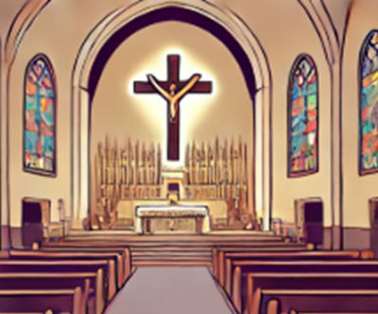

ST. DOMINIC'S CHURCH
What is Confirmation?
01
Strengthens Your Faith
Makes your faith stronger
02
Receive the Holy Spirit
You get special gifts from the Holy Spirit
03
Part of the Church
You fully join the Catholic Church
1

Slide 3

ST. DOMINIC'S CHURCH
Meaning of Confirmation
01
Deepens Your Relationship with God
Brings you closer to God and Jesus
02
Helps You Make Good Choices
The Holy Spirit guides you to live a good and loving life
03
Shows You’re Committed
It’s a way of saying “yes” to being a follower of Jesus
2

Slide 4

ST. DOMINIC'S CHURCH
What is a Sponsor?
A SPONSOR’S ROLE
REQUIREMENTS
A Faith Guide
Be a Confirmed Catholic
Someone who helps you grow in your faith
They must have received the Sacrament of Confirmation
A Supporter
They pray for you and encourage you during your Confirmation journey
Practice Their Faith
A Role Model
They should attend Mass and live as a good Catholic example
They show you how to live as a follower of Jesus
At Least 16 Years Old
Sponsors must be mature enough to guide you in your faith.
3

Slide 5


4

Slide 6



5

Slide 7
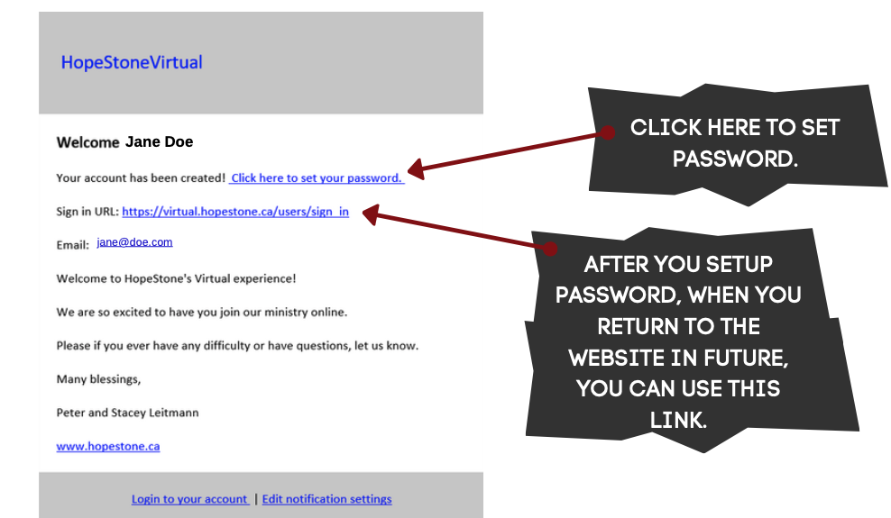
6

Slide 8
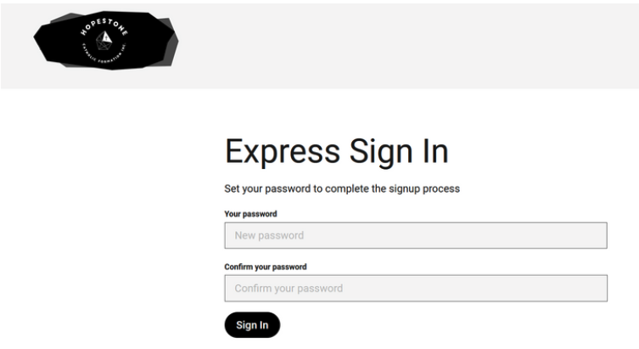
7

Slide 9
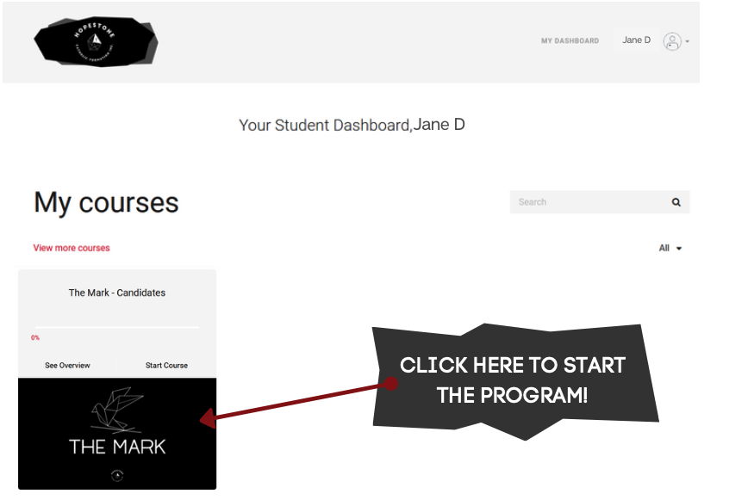
8

Slide 10

9

Slide 11
ST. DOMINIC'S CHURCH
Our preparation journey
The parish calendar and The Mark guide our preparation for Confirmation.
OCT 16
NOV 16
FEB 15
MAY 8/15
Kickoff
The Mark
The Mark
Retreat
7:00 PM
3 modules released
3 more modules
1:00–6:00 PM
NOV 16
JAN 23 + 30
APR 17
JUN 1 + 3
Registration
Bookmark
Movie night
Confirmation
deadline
after 5 PM Mass
after 5 PM Mass
See slide 9
Keep this schedule handy throughout the formation year.
10
Notes:
Parish dates and contact: attached 2026–2027 sacramental preparation calendar. Program information: https://www.hopestone.ca/confirmation (accessed October 13, 2026). Session titles follow the HopeStone full program. The parish calendar schedules two releases of three modules.

Slide 12
ST. DOMINIC'S CHURCH
The Mark at a glance
A program for candidates
HopeStone’s full Confirmation program combines video teaching with reflection.
6
2
video sessions
release dates
Two sets of three modules
First set: November 16
Second set: February 15
11
Notes:
Parish dates and contact: attached 2026–2027 sacramental preparation calendar. Program information: https://www.hopestone.ca/confirmation (accessed October 13, 2026). Session titles follow the HopeStone full program. The parish calendar schedules two releases of three modules.

Slide 13

ST. DOMINIC'S CHURCH
How each session works
IN EACH SESSION
CANDIDATE RESPONSE
Opening prayer
Reflection
A priest leads the opening prayer.
Reflect on the teaching and its meaning.
Catechesis
Journal or discussion
A HopeStone presenter shares the teaching.
Complete the journal entry or group questions.
Testimony
At home
A personal story connects faith and life.
Discuss the questions with a parent and sponsor.
12
Notes:
Parish dates and contact: attached 2026–2027 sacramental preparation calendar. Program information: https://www.hopestone.ca/confirmation (accessed October 13, 2026). Session titles follow the HopeStone full program. The parish calendar schedules two releases of three modules.

Slide 14
ST. DOMINIC'S CHURCH
The first three sessions
01
The One
Session 1
02
The Holy
Session 2
03
The Catholic
Session 3
First module release
NOVEMBER 16
13
Notes:
Parish dates and contact: attached 2026–2027 sacramental preparation calendar. Program information: https://www.hopestone.ca/confirmation (accessed October 13, 2026). Session titles follow the HopeStone full program. The parish calendar schedules two releases of three modules.

Slide 15
ST. DOMINIC'S CHURCH
The final three sessions
04
The Apostolic
Session 4
05
The Church
Session 5
06
The Mark
Session 6
Second module release
FEBRUARY 15
14
Notes:
Parish dates and contact: attached 2026–2027 sacramental preparation calendar. Program information: https://www.hopestone.ca/confirmation (accessed October 13, 2026). Session titles follow the HopeStone full program. The parish calendar schedules two releases of three modules.

Slide 16
ST. DOMINIC'S CHURCH
Bookmark activity and movie night
JAN
Bookmark activity
23 & 30
After the 5:00 PM Mass
The parish calendar marks this activity as mandatory.
APR 17
Movie night
PARISH EVENT
After the 5:00 PM Mass
Movie night
15

Slide 17
ST. DOMINIC'S CHURCH
Retreat, reflections and rehearsal
The final parish events lead into the Confirmation celebrations.
MAY 8
Confirmation retreat
MAY 15
Confirmation retreat
1:00–6:00 PM
1:00–6:00 PM
MAY 22
Homily reflections
Due date
MAY 29
Rehearsal
3:00 PM
JUNE 1 + 3
Confirmation
Both schools
7:00 PM
Keep these dates handy and watch for parish reminders.
16

Slide 18
ST. DOMINIC'S CHURCH
Expectations
WEEKLY EXPECTATIONS
PARTICIPATION
1) Weekly Mass attendance
3) Choose one option
Advent play
Passion play
One-page Gospel of Luke reflection
2) Weekly homily notes
Submit before May 22.
17

Slide 19
ST. DOMINIC'S CHURCH
Confirmation celebrations
JUNE 3
JUNE 1
ST. DOMINIC'S
QUEEN OF HEAVEN
7:00 PM
Both celebrations
18
Notes:
Parish dates and contact: attached 2026–2027 sacramental preparation calendar. Program information: https://www.hopestone.ca/confirmation (accessed October 13, 2026). Session titles follow the HopeStone full program. The parish calendar schedules two releases of three modules.

Slide 20
ST. DOMINIC'S CHURCH
Frequently asked questions
01
What if my child goes to a different school?
We assign Confirmation and retreat dates after the registration deadline.
02
What if I prefer a specific Confirmation date?
When we send the Confirmation election form in the spring, please select the date you prefer, we will do our best to accommodate.
03
What if my child has not been baptized or received First Communion?
Both sacraments must be completed before Confirmation. Please contact the parish office to arrange them.
19
Notes:
FAQ answers supplied by the parish in this conversation. Confirmation and retreat dates for candidates at other schools are assigned after registration closes. Families can express a preferred Confirmation date on the spring election form. Baptism and First Communion are required before Confirmation.

Slide 21
ST. DOMINIC'S CHURCH
How to register
Registration at the parish office
Please drop off the following:
01
Completed registration form
02
Baptism certificate
03
Registration fee, paid by Visa or cash at the office
Parish office hours
Monday to Friday, 9:00 AM–5:00 PM
Closed for lunch, 12:00–1:00 PM
20
Notes:
Registration instructions and parish office hours supplied by the parish in this conversation. Submit the registration form, baptism certificate and registration fee at the parish office. Payment options: Visa or cash. Office hours: Monday to Friday, 9 AM to 5 PM, closed noon to 1 PM.

Slide 22
ST. DOMINIC'S CHURCH
Candidate and family checklist
1
Register by NOV 16
Confirm registration details with the parish office.
2
Open the HopeStone email
Check junk mail, set the password, and do not create a second account.
3
Complete each released session
Watch the full video and complete the questions before moving on.
4
Keep every parish date handy
Attend the parish events and submit homily reflections by May 22.
Church contact
thosegonsalves@gmail.com
virtual.hopestone.ca
21
Notes:
Parish dates and contact: attached 2026–2027 sacramental preparation calendar. Program information: https://www.hopestone.ca/confirmation (accessed October 13, 2026). Session titles follow the HopeStone full program. The parish calendar schedules two releases of three modules.

